Slide 1
Chapter 11

Slide 2
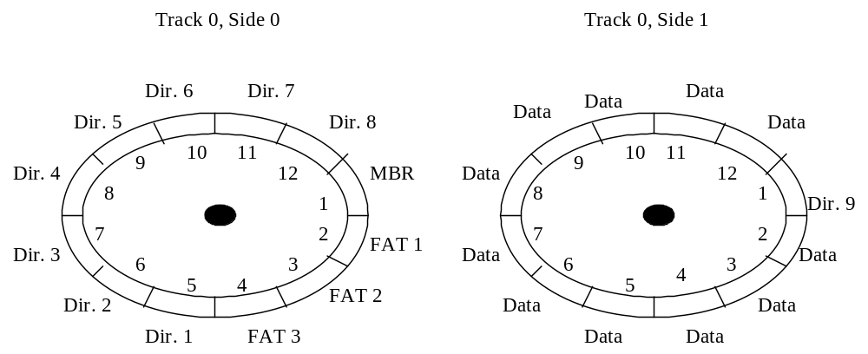
DISK ORGANIZATION

Slide 3
DISK ORGANIZATION
DOS:
BIOS locates the sectors by a 3D number scheme (cylinder number, head number, sector number).
DOS only uses sector numbers and numbers the sectors sequentially from outside to inside. The numbering scheme starts with cylinder 0, head 0, and sector 1 (in BIOS terms) and continues through the remainder of the disk.
The boot record is always a single sector located at cylinder 0, head 0, and sector 1. The boot record contains info on how to start the OS. All disks have a boot record even if it is not used.
The FAT follows the boot record at cylinder 0, head 0, and sector 2. The size (# of sectors allocated to it) of the FAT may vary from drive to drive.
The directory follows the FAT. The size of the directory may vary from drive to drive.
The data space follows the directory and makes up the remainder of the drive.

Slide 4
DISK ORGANIZATION
UNIX:
BIOS locates the sectors by a 3D number scheme (cylinder number, head number, sector number).
UNIX uses a file system based on blocks (Each block is one or more sectors).
The first block of the partition is always for bootstrapping (even if it is not required).
The super block follows. The superblock contains system attributes and file system metadata.
The I-list follows the superblock. The size (# of blocks allocated / number of I-nodes) of the I-list may vary from drive to drive.
The storage space (for file contents) follows the I-list and makes up the remainder of the drive.

Slide 5
DISK ORGANIZATION
PARTITIONS:
Partitions are low level structures on which directories and files reside. A single drive can be broken into several partitions or several drives can be combined into a single partition (even across networked machines).

Slide 6
DISK ORGANIZATION
FILE ALLOCATION TABLE (FAT):
File-Allocation-Table (FAT) used by DOS and OS/2 is an important variation on the linked list idea:
  The FAT is stored at the beginning of each partition.
  The FAT has one entry for each disk block and is indexed by block number.
  The directory entry contains the block number of the first block of the file.
  The FAT entry (indexed by that block number) contains the block number of the next block of the file.
  Unused blocks have a FAT entry of 0.
  Bad blocks are also recorded in the FAT.

Slide 7
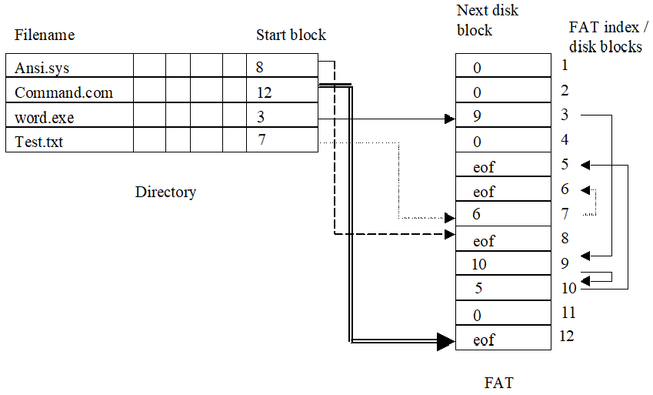
DISK ORGANIZATION
FILE ALLOCATION TABLE (FAT):

Slide 8
DISK ORGANIZATION
FILE ALLOCATION TABLE (FAT):
Read a file - Search directory for the file. Use directory’s start value to determine where in the FAT the file starts. Use the FAT to determine which disk blocks hold the file.
Write a new file - Search the directory for the file. Append file name, start block, etc on directory. Search the FAT to find enough unused disk blocks to hold the file.
Erase a file - Search the directory for the file. Use directory’s start value to determine where in the FAT the file starts. Use FAT to determine which other FAT entries are used by the file. We then remove these entries and the file data from the directory.
Overwrite a file - Search the directory for the file. Use the directory’s start value to determine where in the FAT the file starts. Use the FAT to determine which other FAT entries are used by the file. We then:
  Remove the entries from the FAT and write the file as if it were a new file.
  Leave the FAT alone. Replace the disk blocks with new data.

Slide 9
DISK ORGANIZATION
I-NODE:
I-NODE used by UNIX is a variation on the indexed idea:
  Each file has its own I-node. Unlike DOS’s FAT, the I-nodes only exist for files. Empty blocks do not have an I-node.
  The directory entry (a simple file in UNIX) contains the I-node number for each file.
  The I-node contains information about the file. It also contains an index (multi-level) that points to the blocks containing the file.
  Unused blocks are linked together and recorded in a free list.

Slide 10
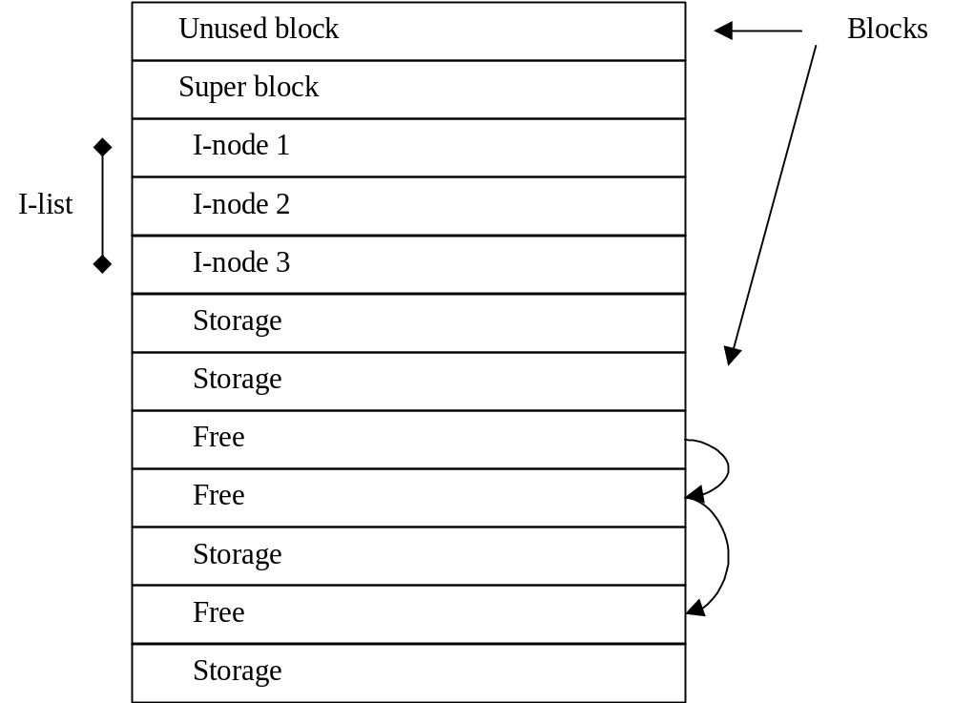
DISK ORGANIZATION
I-NODE:

Slide 11
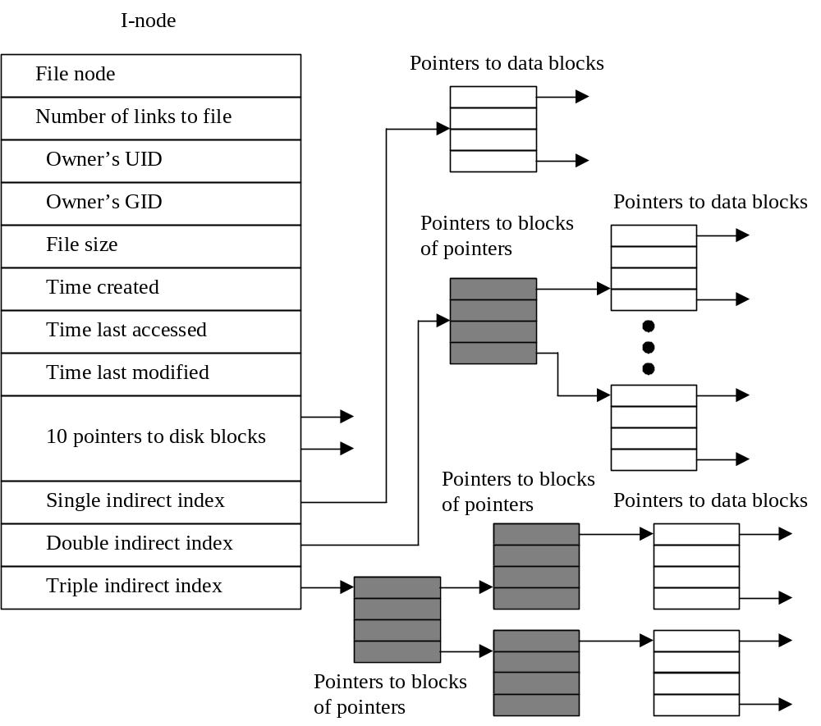
DISK ORGANIZATION
I-NODE:

Slide 12
DISK ORGANIZATION
I-NODE:
The I-node can directly hold up to 10 disk block locations. Making small files (< 10 blocks) efficient to load.
The size of the I-node (size of disk block) determines how big a file can be. As shown below:
1K byte block -> 10 K indexed in I-node
16 gig files maximum
10 blocks via I-node
256 more blocks via 1st level indirect index
256*256 more blocks via 2nd level indirect index
256*256*256 more blocks via 3rd level indirect index

Slide 13
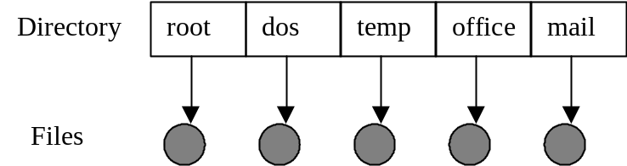
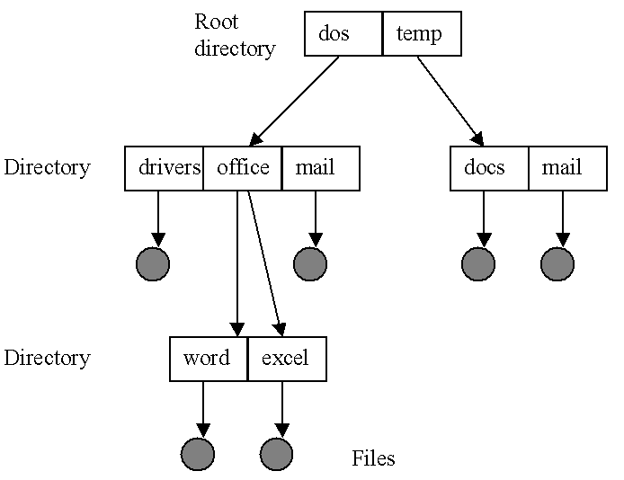
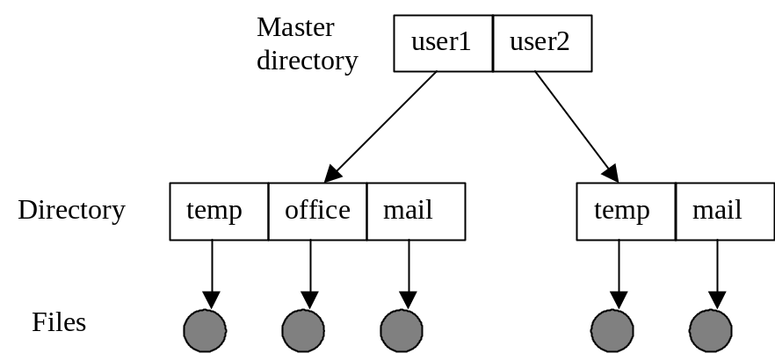
DISK ORGANIZATION
DIRECTORIES:
Disk directories can be organized in several ways:
Single-level:
Tree (DOS):
Two-level:

Slide 14
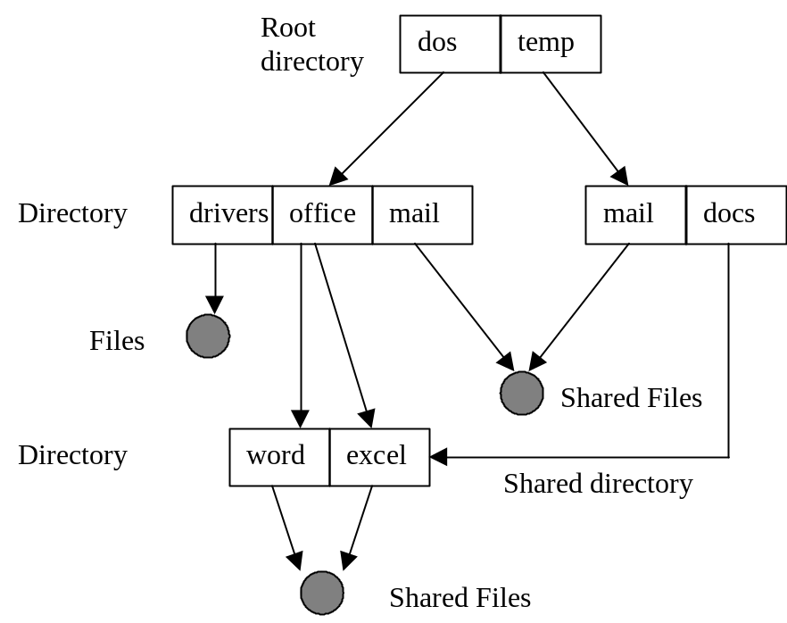
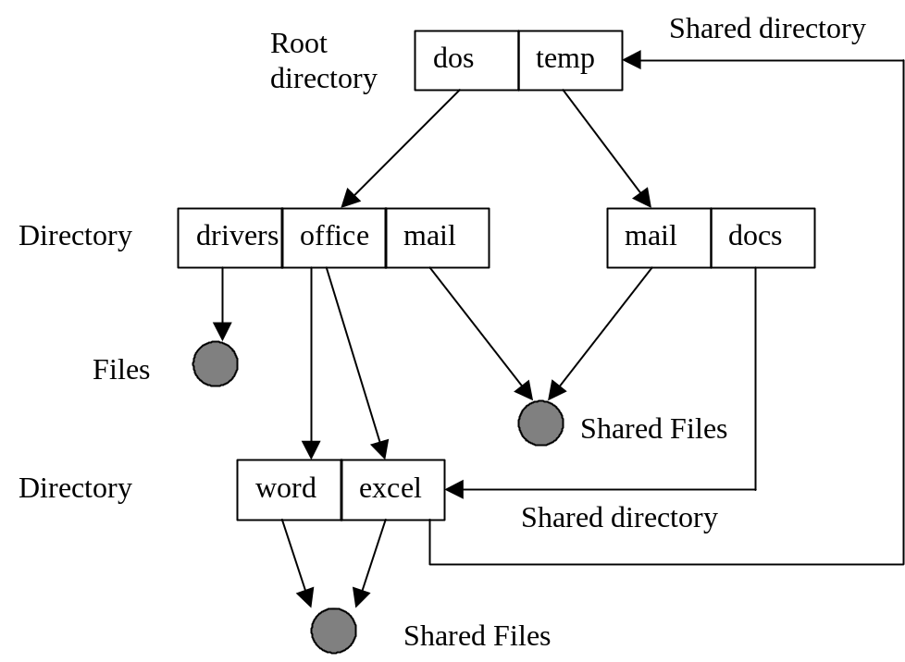
DISK ORGANIZATION
DIRECTORIES:
Disk directories can be organized in several ways:
Acyclic-graph (UNIX via links):
General graph (UNIX via links):

Slide 15
DISK ORGANIZATION
UNIX LINKS:
In UNIX we can create two types of pointers (links) to other directories (very useful).
  Symbolic links – Allow shared files and shared directories. Shared files allow you to create circular references, but they do not “work.”. Shared directories do not appear to allow circular references between directories. In fact, UNIX only allows 10 traversals of any symbolic links before it fails.
  Hard links – In UNIX, hard links can only refer to files. Therefore, cycles are not possible.
  So, UNIX behaves as an acyclic graph.
  http://www.youtube.com/watch?v=HAJM5PJxv6E
  (Linux: Hard and Soft Links)

Slide 16


